Slide 1

HCI - Assignment n.2
Design and prototyping of an application using a human-centered approach
Deliverable n. 1: Requirement Analysis
Project Title: UA Talent MarketPlace
Group: Bruno Gomes, Alexandre Martins, João Gonçalves
Lab Class: P3
HCI 2020-2021

Slide 2
Introduction
UA Talent Marketplace
Contextualization and motivation:
Meeting the demand for a platform where users can sell creative talents like design, writing, photography, etc.;
While also providing students with opportunities to collaborate on academic or extracurricular projects.
Project significance:
Addressing the need for monetizing creative skills and fostering student collaboration.
Relation to other courses:
AS for planning the platform development.
SIO would be essential for implementing strong cybersecurity measures to safeguard user data and transactions on the platform.
Personal interest:
Combining technology and creativity to incentivize entrepreneurship.
HCI 2020-2021
2

Slide 3
Project Objectives
UA Talent Marketplace
Our high-level goals:
Create collaboration among users;
Offer a wide range of creative talents;
Facilitate monetization of those talents;
Expected outcomes:
User income generation through creativity;
Collaboration and mutual learning;
Higher consumer satisfaction;
The benefits:
Business opportunities for users;
Community engagement and networking;
Convenience and flexibility (remote marketplace);
HCI 2020-2021
3

Slide 4

Personas
UA Talent Marketplace
António Morgado
20 years old;
Student at Universidade de Aveiro;
He finds some classes too difficult, therefore, making him seek for help;
Pedro can’t pay for a private tutor, he wants someone to help him with his university projects for a reasonable price.
HCI 2020-2021
4
Notes:
Se ele é de perto ou de longe, está ou nao ao fim de semana, saber o que estuda, definir a materia que ele tem dificuldades,
Este pode ser um modelo de subscriçao, podiamos usar os outros como modelos de compra unica

Slide 5

Personas
UA Talent Marketplace
Mário Figueiredo
24 years old;
Currently developing his master’s thesis at UA;
He’s short of money to pay for his university fees;
Mário is willing to spend some of his time helping other students in need, therefore getting paid by anyone who’s interested in his services.
HCI 2020-2021
5

Slide 6
Scenarios
UA Talent Marketplace
Scenario 1:
António Morgado, is struggling with difficult classes;
He discovers UA Talent MarketPlace for academic support and finds a post from Mário Figueiredo;
They connect on the website, discuss António's needs, and agree to collaborate on his projects;
Over a few weeks, Mário guides António through his coursework;
António is thankful for Mário's help and leaves a positive review on the site.
HCI 2020-2021
6
Notes:
Ser mais especifico nas dificuldades, nao tao vago
Definir o tipo de coursework

Slide 7
Scenarios
UA Talent Marketplace
Scenario 2:
Mário Figueiredo, is short of money to pay for his university fees;
He opens up UA Talent MarketPlace and publishes a post;
He waits for someone to click on the post so he can help and also get paid.
HCI 2020-2021
7
Notes:
Como vai pagar, que tipo de conversa vai ter sobre marcar datas etc

Slide 8
Tasks
UA Talent Marketplace
0
Get help
2 can be skipped if post already shows up
1
Open UA MarketPlace
2
Search for specific
post
3
Click on post
3.1
3.2
3.3
Discuss with
original poster
Give Payment
Leave review
HCI 2020-2021
8
Notes:
Especificar como vai funcionar o 3.1

Slide 9
Tasks
UA Talent Marketplace
0
Create new post
2 can be skipped if already has an account
1
2
Create account
3
Open UA MarketPlace
Go to create a post page
HCI 2020-2021
9
Notes:
Posso meter o diploma, como provo que sou bom, rating, que cadeiras sou bom

Slide 10
Requirements
UA Talent Marketplace
Define a set of requirements (non-functional, functional, …) based on the objectives and personas:
Functional Requirements -
User Registration
Talent Listing Service
Search
Communication Tools
Student Collaboration
Profile Management
Non-functional requirements –
Security
Performance
Scalability
Usability
Accessibility
HCI 2020-2021
10

Slide 11
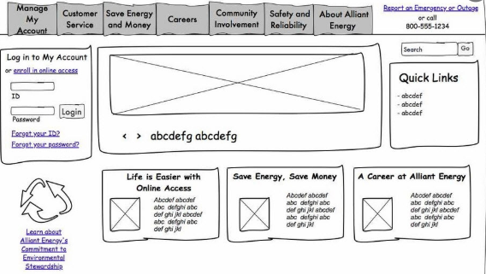
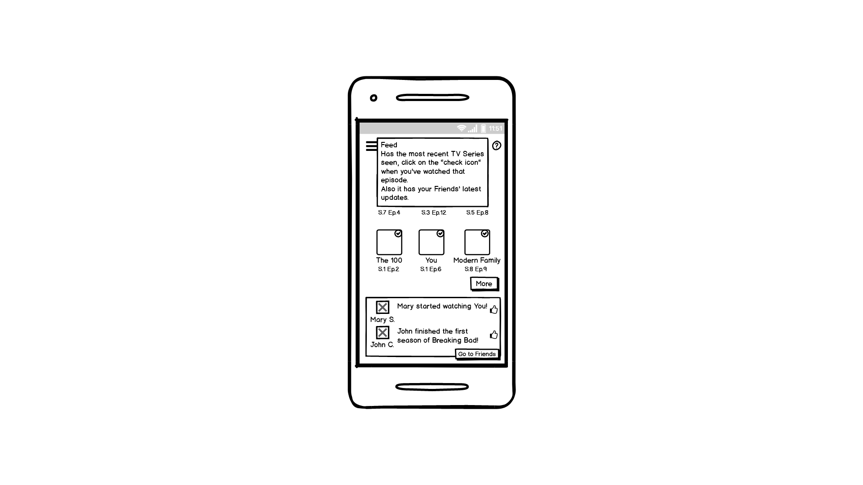
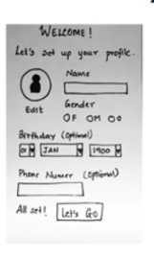
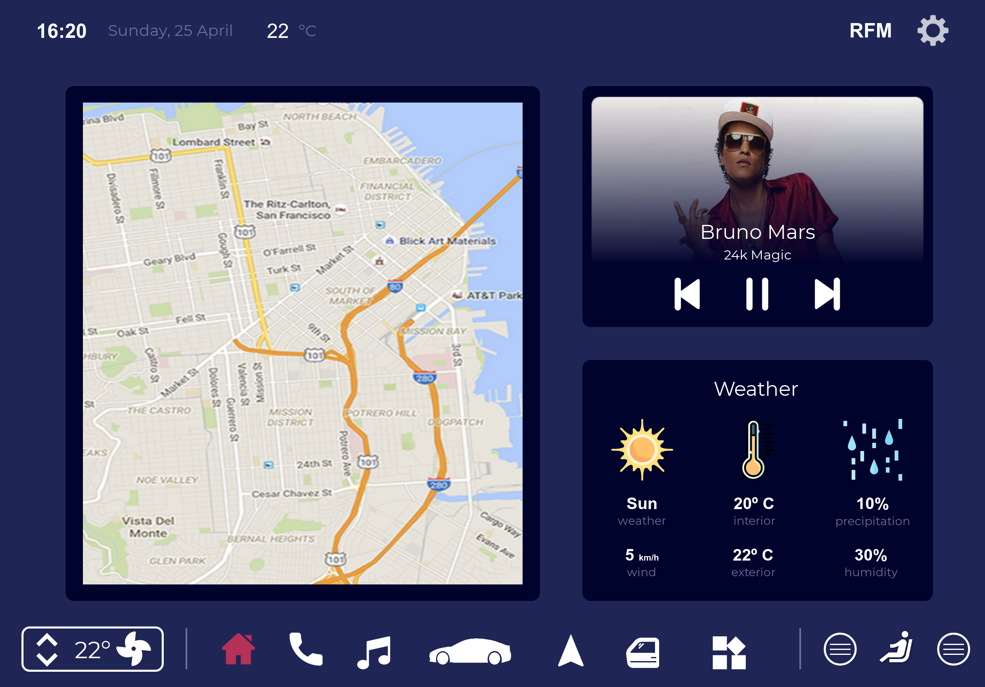
Next steps
UA Talent Marketplace
We are considering making a digital prototype, using tools such as proto.io.
We’ll test the prototype by observing users trying to perform tasks on it and asking questions based on their experience with the interface
HCI 2020 - 2021
11

